Slide 1

INT247 Machine Learning Foundations
Lecture #5.0
Normalization and Feature Scaling

Slide 2
Feature Scaling
Used for standardization of independent variables of data features.
Dataset contains features varying in magnitude, units and range. For example:
Gold_weight measured in gms.
Iron_weight measured in Kg.
Euclidian distance is not the best method to scale the features.

Slide 3
Techniques of Feature Scaling
Standardisation
Normalization

Slide 4


Standardisation
$$x^{′}=\frac{x−mean(x)}{}$$
$$σ$$
This redistributes the features with their mean =0 and standard deviation =1.

Slide 5

Normalisation
$$x^{′}=\frac{x−min(x)}{max\left(x\right)−min(x)}$$

Slide 6
Exercise
Consider the following dataset:
X
0.0
1.0
2.0
3.0
4.0
5.0
Perform standardisation and normalisation on dataset.

Slide 7
Solution
Consider the following dataset:
X Normalized Standardized
0.0 0.0 -1.336306
1.0 0.2 -0.801784
2.0 0.4 -0.267261
3.0 0.6 0.267261
4.0 0.8 0.801784
5.0 1.0 1.336306

Slide 8
Over-fitting
Model performs much better on a training dataset than on the test dataset.
Model fits the parameter too closely to a particular observation in the training dataset.
Not generalize the real data.

Slide 9
Reduce Generalization Errors
Collect more training data.
Introduce a penalty for complexity via regularization.
Choose a simpler model with fewer parameters.
Reduce the dimensionality of the data.

Slide 10
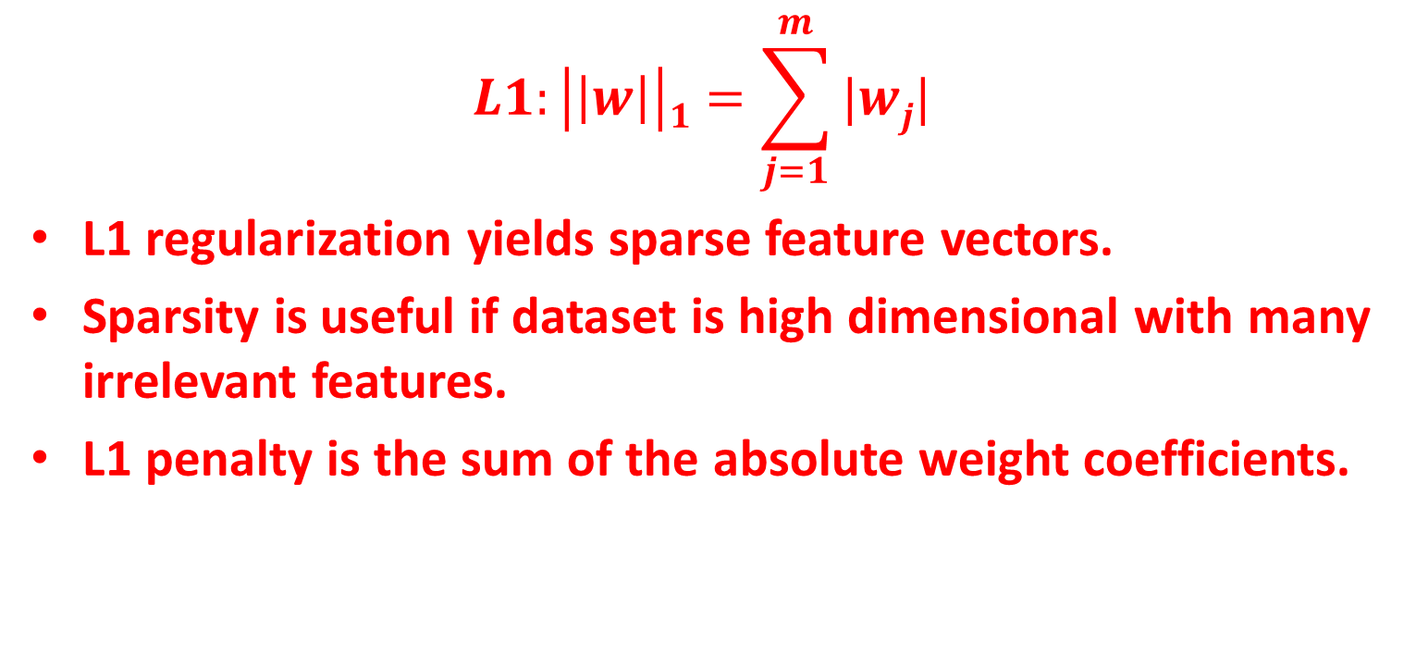
Sparse Solution With L1 Regularization
$$L1:\left|\left|w\right|\right|1=\sum_{j=1}^{m}{|wj|}$$
L1 regularization yields sparse feature vectors.
Sparsity is useful if dataset is high dimensional with many irrelevant features.
L1 penalty is the sum of the absolute weight coefficients.

Slide 11

Sparse Solution With L2 Regularization
$$L2:\left|\left|w\right|\right|12=\sum_{j=1}^{m}{|wj|}2$$
L2 penalty is the sum of the square of weights.

Slide 12
Sequential Feature Selection Algorithms
Family of greedy search algorithms.
Reduce an initial d-dimensional feature space into k-dimensional feature sub-space where k<d.
Automatically select a subset of features that are most relevant to the problem.

Slide 13
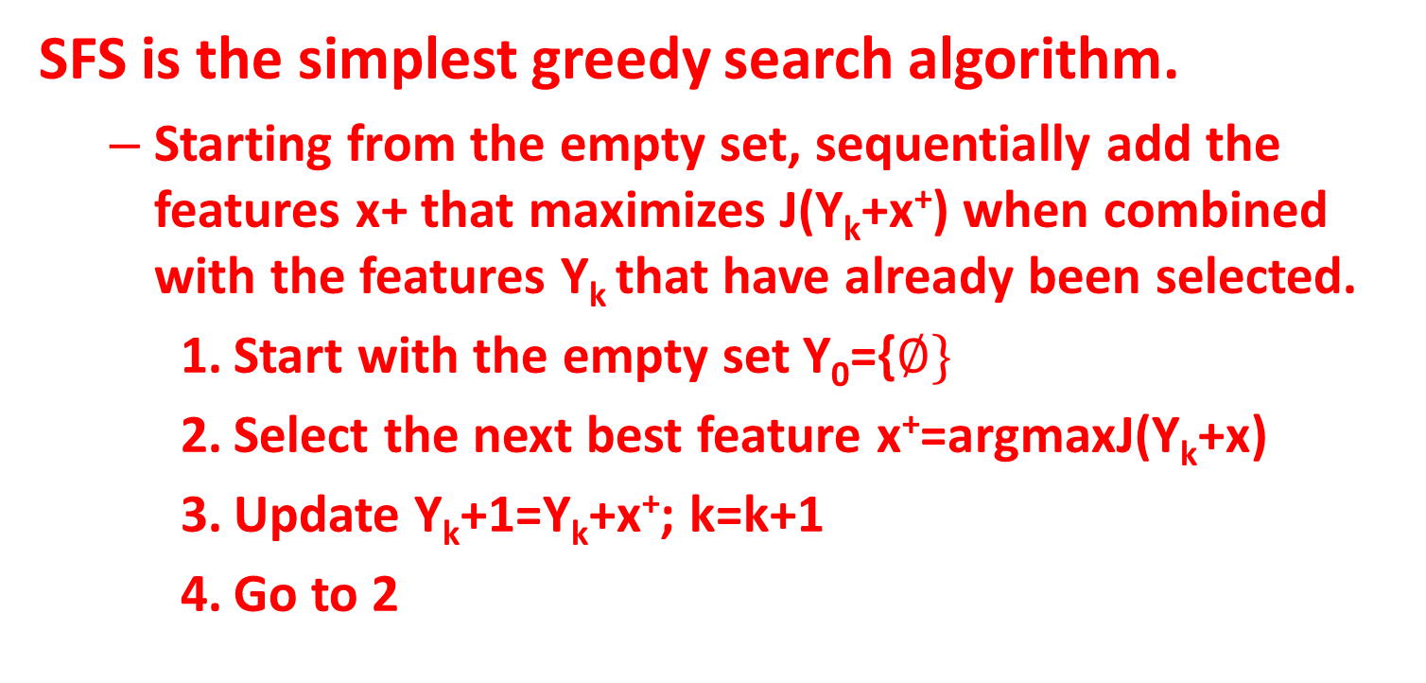
Sequential Forward Selection (SFS) Algo.
SFS is the simplest greedy search algorithm.
Starting from the empty set, sequentially add the features x+ that maximizes J(Y_{k}+x⁺) when combined with the features Y_{k}that have already been selected.
Start with the empty set Y₀={$∅\}$
Select the next best feature x⁺=argmaxJ(Y_{k}+x)
Update Y_{k}+1=Y_{k}+x⁺; k=k+1
Go to 2

Slide 14
Sequential Forward Selection (SFS) Algo.
SFS performs best when the optimal subset is small.
The search space is drawn like an ellipse to emphasize the fact that there are fewer states towards the full or empty sets.

Slide 15
Example
Run SFS to completion for the following objective function:
J(X)=-2x₁x₂+3x₁+5x₂-2x₁x₂x₃+7x₃+4x₄+-2x₁x₂x₃x₄
Where x_{k} are indicator variables, which indicate whether the k^{th} feature has been selected (x_{k}=1) or not (x_{k}=0)
J(x1)=3 J(x2)=5 J(x3)=7 J(x4)=4
x3 is maximum: J(x3x1)=10 J(x3x2)=12 J(x3x4)=11
x3x2 is maximum: j(x3x2x1)=11 j(x3x2x4)=16
x3x2x4 is maximum: j(x3x2x4x1)=13

Slide 16
Sequential Backward Selection (SBS) Algo.
Aims to reduce the dimensionality of the initial feature subspace.
Initialize the algorithm with k=d where d is the dimensionality of the full feature space X_{d}.
Determine the feature x⁻ that maximizes the criterion x⁻=argmaxJ(X_{k}-x) where xϵX_{k}.
Remove the feature x⁻ from the feature set: X_{k}-1=X_{k}-x⁻, k=k-1.
Terminate if k equals the number of desired features, if not, go to step 2.

Slide 17
Sequential Backward Selection (SBS)
SBS works best when the optimal feature subset is large, since SBS spends most of its time visiting large subsets.
The main limitation of SBS is its inability to re-evaluate the usefulness of a feature after it has been discarded.

Slide 18
Bidirectional Search (BDS)
BDS is a parallel implementation of SFS and SBS.
SFS is performed from the empty set.
SBS is performed from the full set.
To guarantee that SFS and SBS converge to the same solution.
Features already selected by SFS are not removed by SBS.
Features already removed by SBS are not selected by SFS.

Slide 19
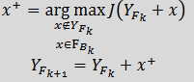
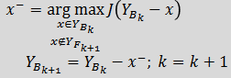

Bidirectional Search (BDS)
Start SFS with YF={$∅\}$
Start SBS with YB=X
Select the best feature
Remove the worst feature
Go to step 2

Slide 20
Selecting Features Using Random Forests
There are two different methods for feature selection are:
Mean decrease impurity
Mean decrease accuracy

Slide 21
Mean Decrease Impurity
Impurity: measure based on which optimal condition is chosen.
During training, it is computed how each feature decreases the weighted impurity in a tree.
For a forest, the impurity decrease from each feature can be averaged and the features are ranked according to this measure.

Slide 22
Mean Decrease Impurity
Feature selection based on impurity reduction is biased towards preferring variables with more categories.
When the dataset has two or more correlated features, any of these correlated features can be used as the predictor.

Slide 23
Mean Decrease Accuracy
Measure the impact of each feature on accuracy of the model.
Permute the values of each feature and measure how much the permutation decreases the accuracy of the model.
Unimportant variables permutation have little or no effect on model accuracy.
Important variables permutation significantly decrease the accuracy.

Slide 24


